Slide 1
Bitmasks
Enjoy

Slide 2
What are bitmasks?
Integers represented as binary numbers
int a = 5
At first, a is just an integer
In binary, a will be represented as 101
Bits at positions 0, 2 (from left) are set or ‘1’
Bit at position 1 is unset or ‘0’
Can be used to represent if the i th position (bit) is “visited” or “unvisited”
Bitmask is used to save space (as opposed to arrays) and can be used with dynamic programming

Slide 3
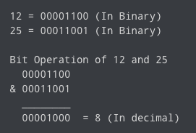
And (&) Bitwise Operator
The output of the bitwise AND operator is:
1 if both of the bits are 1
0 if either of the bits are 0

Slide 4
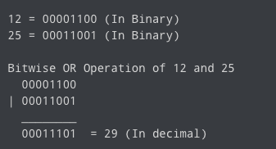
Or (|) Bitwise Operator
The output of the OR operator is:
1 if atleast one of the bits is 1
0 if both of the bits are 0

Slide 5
Complement (~) Bitwise Operator
An unary operator that changes all 1s to 0s and 0s to 1s
However, it follows something called 2’s complement
2’s complement of a number is equal to the complement of that number plus 1
In general, for any integer n, its bitwise complement is -(n+1)

Slide 6
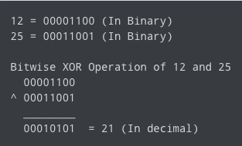
XOR (^) Bitwise Operator
The output of the XOR operator is:
1 if the bits are opposite
0 if the bits are the same

Slide 7
Setting Bits
int a = 5; // 101 in binary
// Set the ith bit from the right starting from 0
a |= (1<<i);
or
a += (1<<i);

Slide 8
Unsetting Bits
int a = 5; // 101 in binary
// Unset the ith bit from the right starting from 0
a &= ~(1<<i);
or
a -= (1<<i);

Slide 9
Checking Set Bits
int a = 6; // 110 in binary
if (a&(1<<1) > 0) // true if the 1st bit from the right is 1

Slide 10
Subset Sums
Check whether the sums of a subset of integers in an array sum to a particular number
Strategy: Check all valid subsets using bitmasks
int n = 5, targetSum = 10;
int[] a = {1, 3, 4, 2, 7};
for(int i = 0; i < (1<<n); i++){
int subsetSum = 0;
for(int j = 0; j < n; j++)
if(i&(1<<j))
subsetSum += a[j];
if(subsetSum == targetSum) // check
}

